Slide 1
Cegal in-person Krafthack 2022

Slide 2
Content
3 4 5 6 9 10 13
Problem Exploration and prepping Model – data exploration Model – considerations Production Dashboard Scalability and transferability

Slide 3
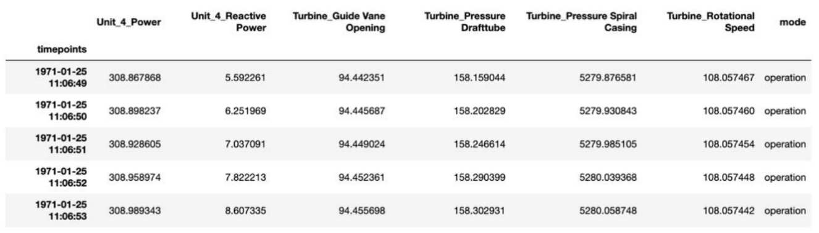
Problem
Prediction data in dataset from sensors
Predict the future tensile values of the 6 bolts with sensors

Slide 4
Exploration and prepping
Removing extreme values
Splitting startup and production data
Removed columns of vibration values because of lacking data
Missing values handled by

Slide 5
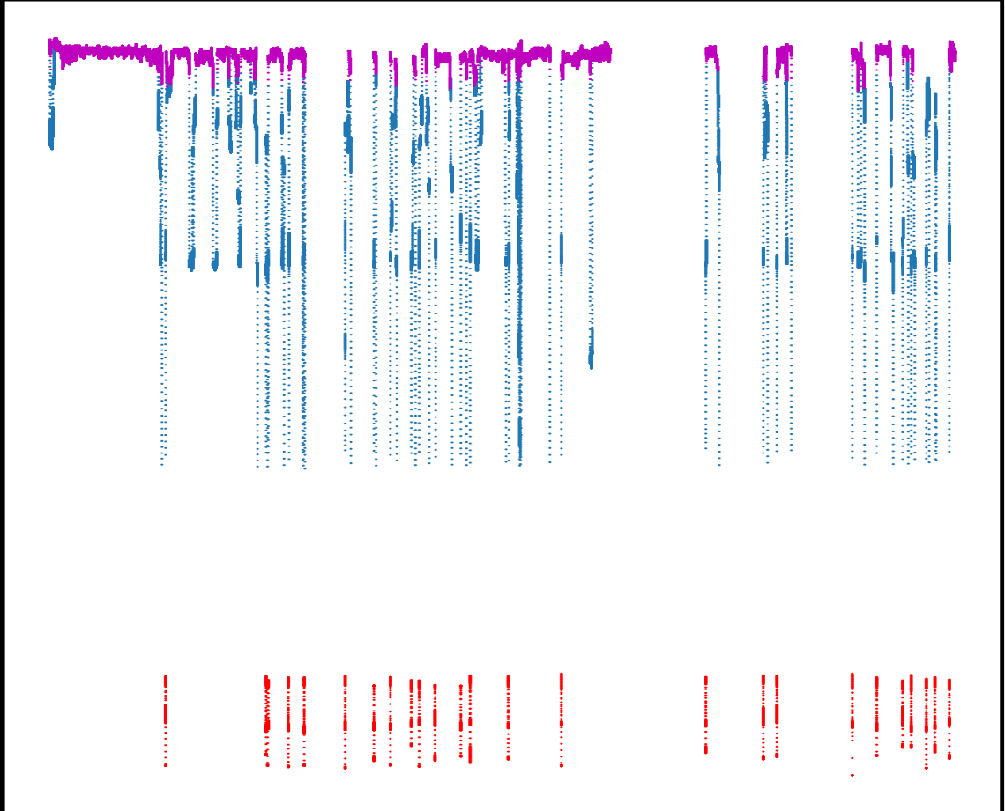
Model – Data Exploration
Guide vane opening in three modes
Interesting findings
Modes: start and operation
Since power regulations effect data, a new mode called regulations was added
Changing temperature due to seasons
Some data is less influential
Reactive Power
Turbine rotational speed (constant)
Vibrations(constant) – should be explored in the future
Dataset augmentation by splitting into three categories
Mode, range, ranges in power changes(in operation)
operation
regulation
start

Slide 6
Model - Considerations
Used three models with random forest regressor
Random forest = ensemble estimator that fits a number of regression decision trees on various sub-samples of the dataset, and uses averaging to improve the predictive accuracy and control over-fitting
Adjustable hyperparameters
n_estimators = number of trees in the forest
max_features = max number of features considered for splitting a node
max_depth = max number of levels in each decision tree
min_samples_split = min number of data points placed in a node before the node is split
min_samples_leaf = min number of data points allowed in a leaf node

Slide 7
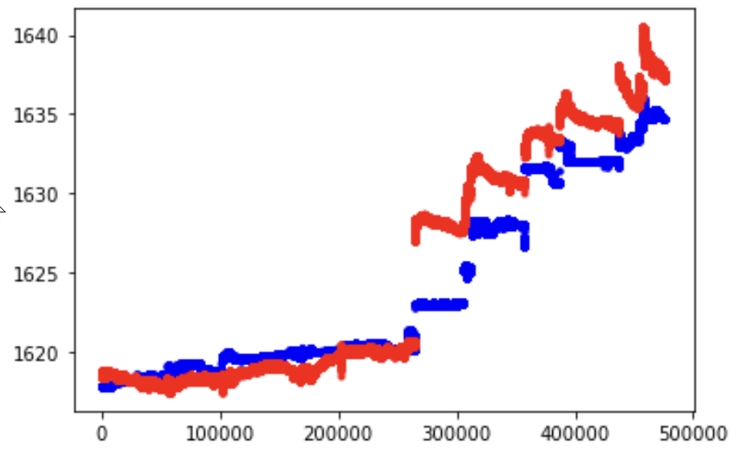
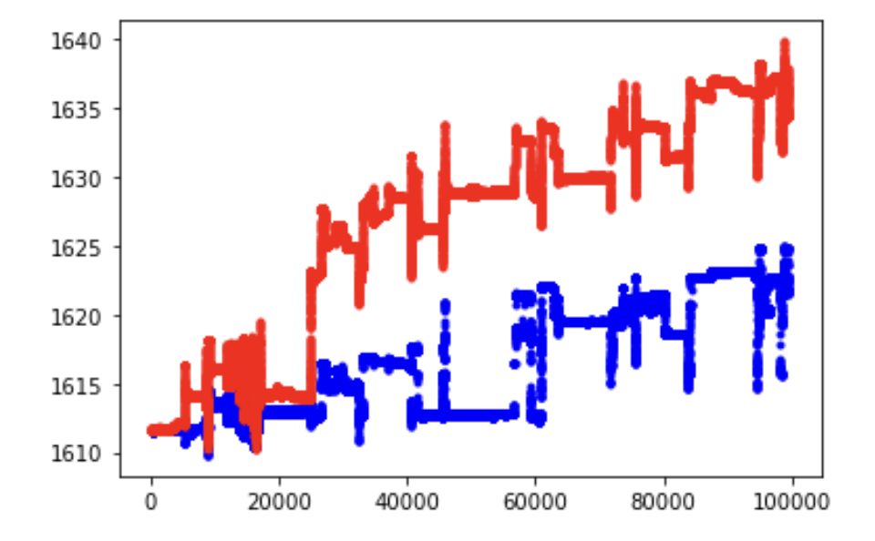
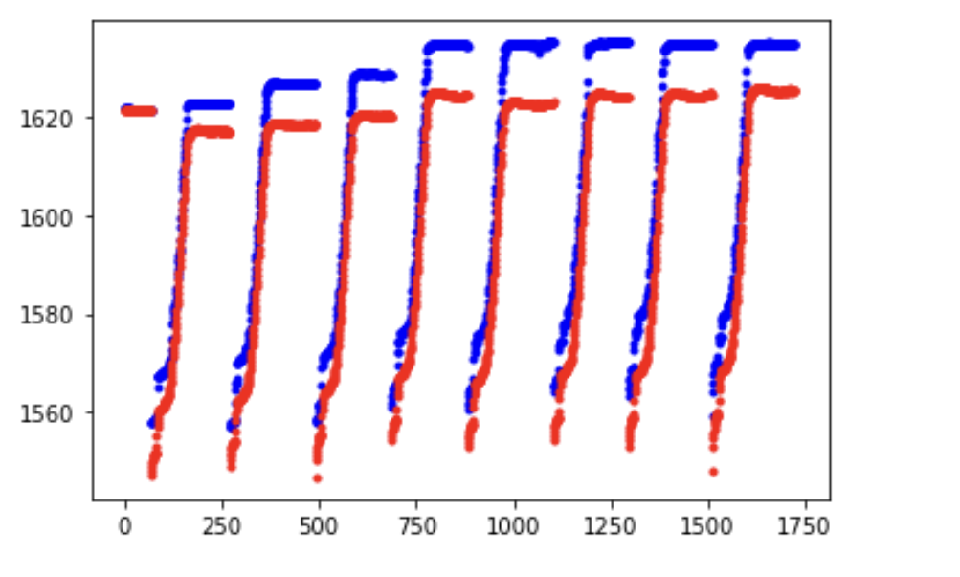
Model - Considerations
An ensemble model was used since it’s a shotgun approach where weak single regressors can be powerful together.
In training the model we used a 0.33/0.67 test/train split that gave a good result without cross-validation.
Prediction for each mode plotted against the test-values of Bolt1 tension
operation
regulation
start

Slide 8
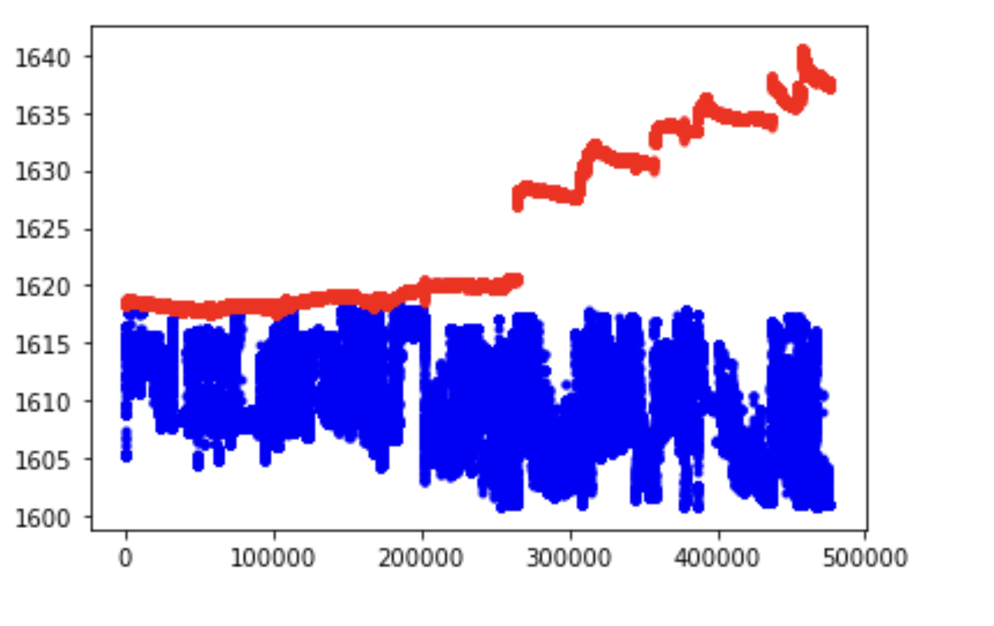
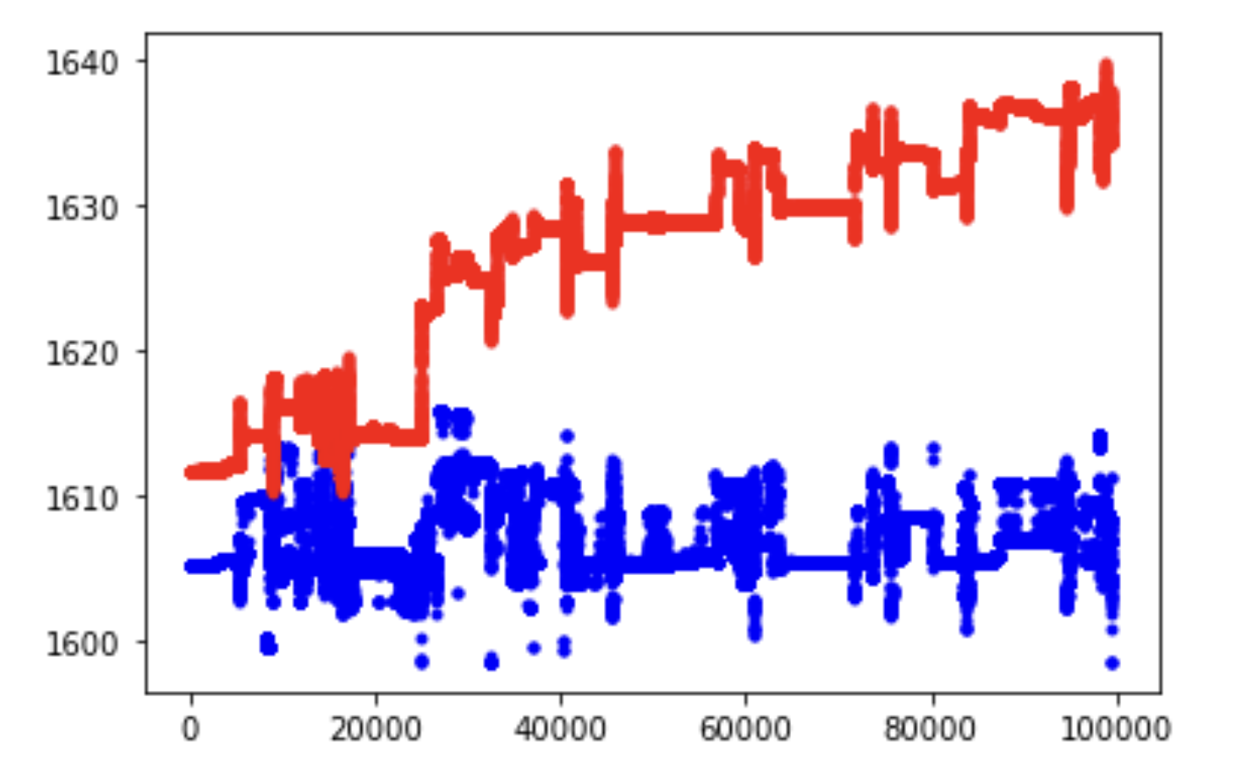
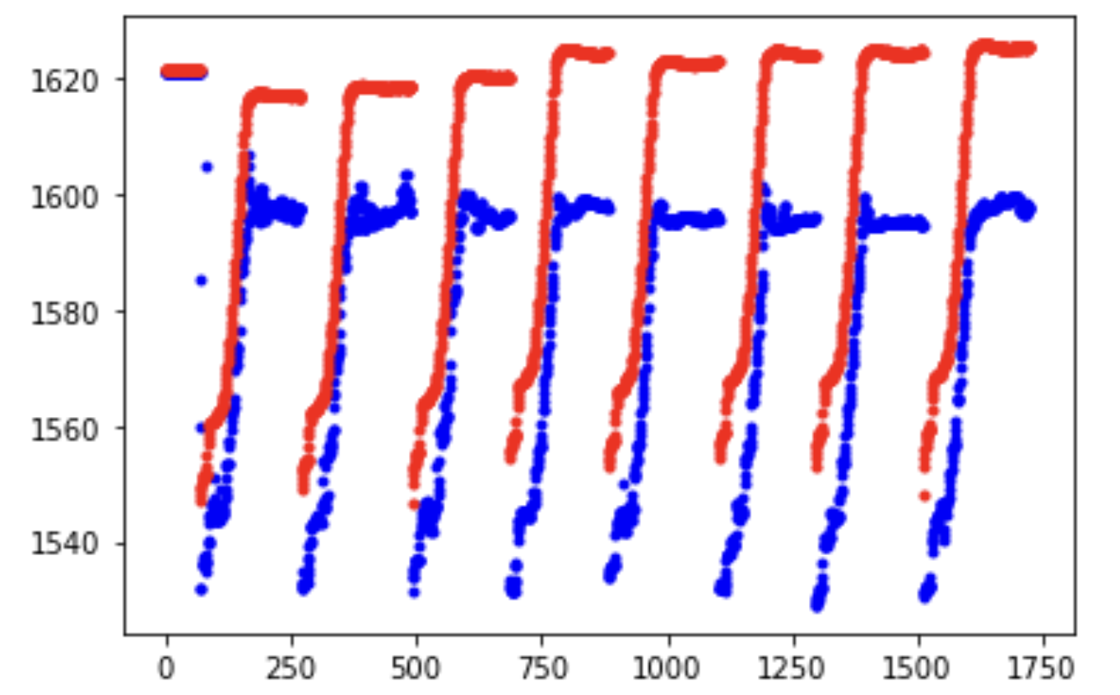
Model - Considerations
While the “prediction_input.parquet” file did not have torsion or temperature data included, the model accuracy has decreased to mean RMSE = 21.14
operation
regulation
start

Slide 9
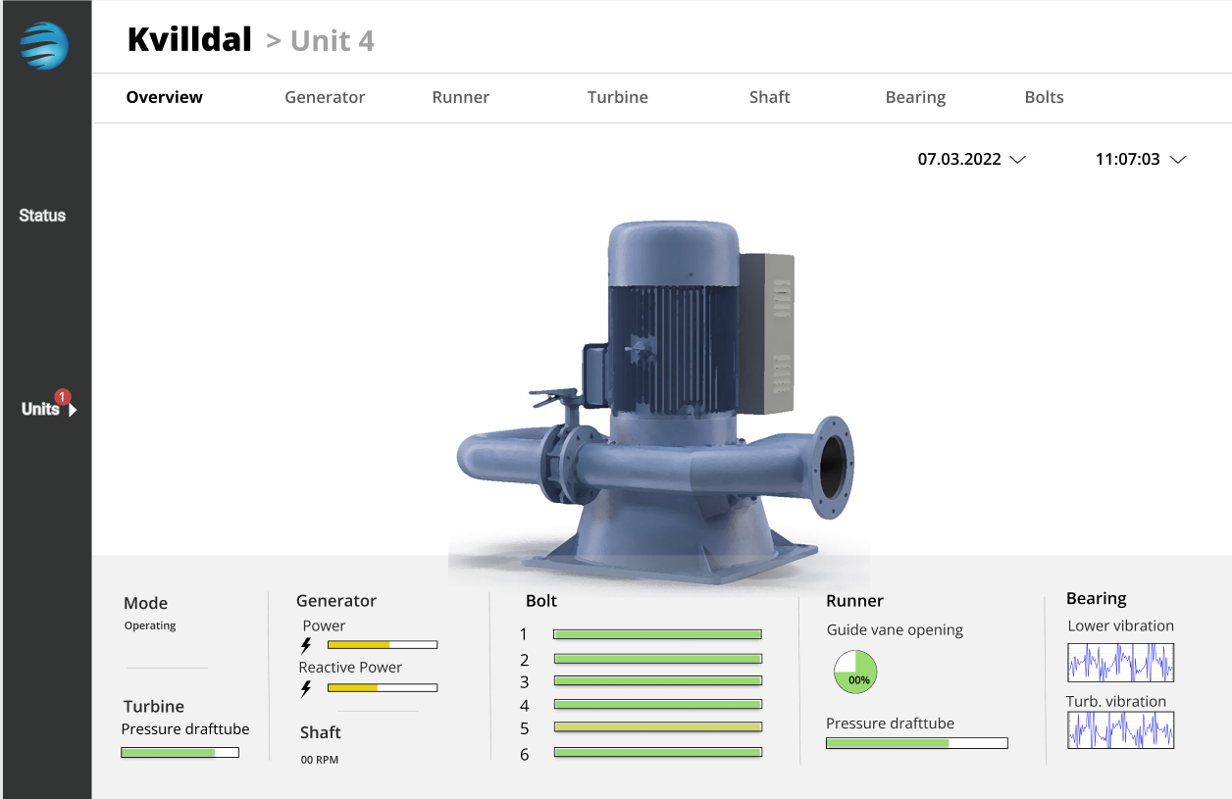
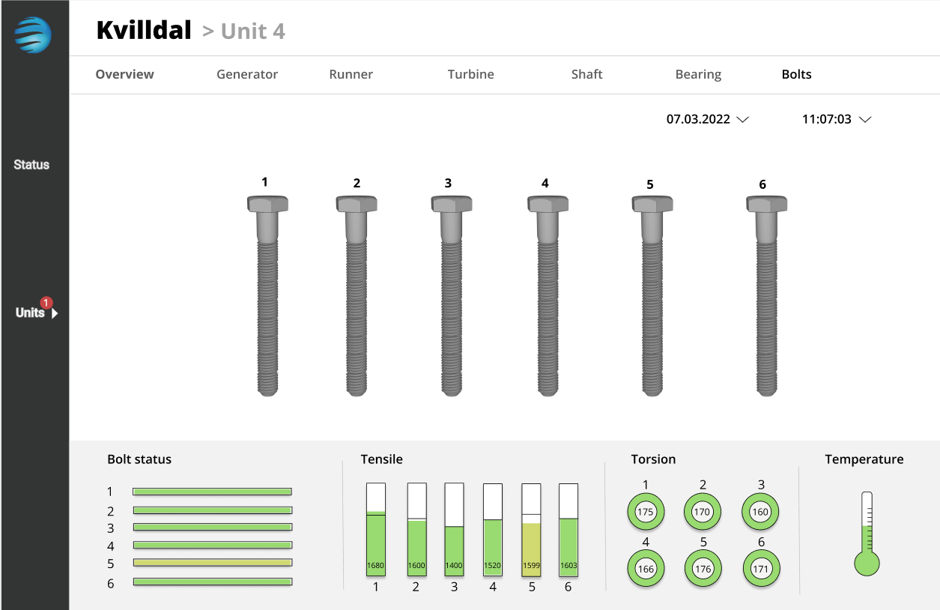
Production
Updating the model – retrain
Publishing to Azure
CSV file to PowerApps
Dashboard notifying maintainers about predictive values

Slide 12
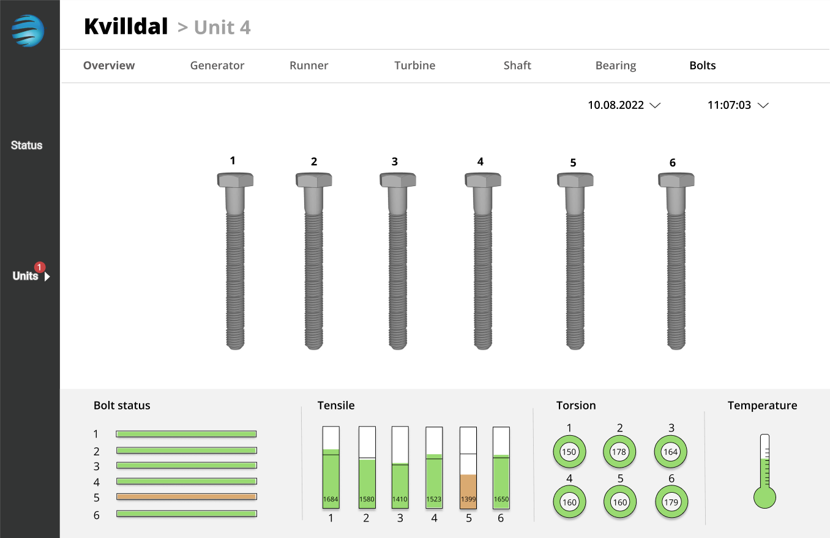

Slide 13
Scalability and transferability
Other applications:
Estimate max power production based on weather conditions and season
Sub-sea installations
Oil rig installations
Maintenance of elevators
Cars service interval
Stock prices
Train maintenance

